Slide 1

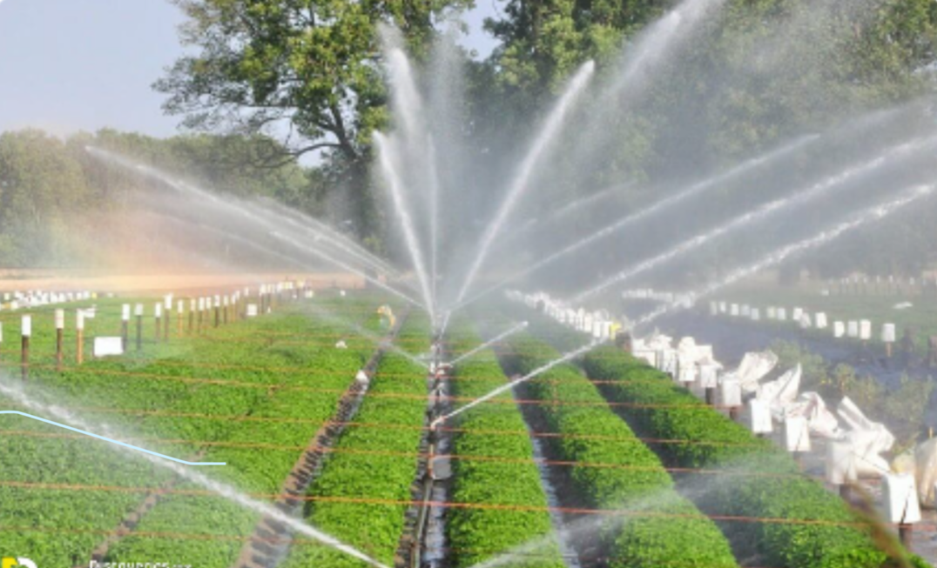
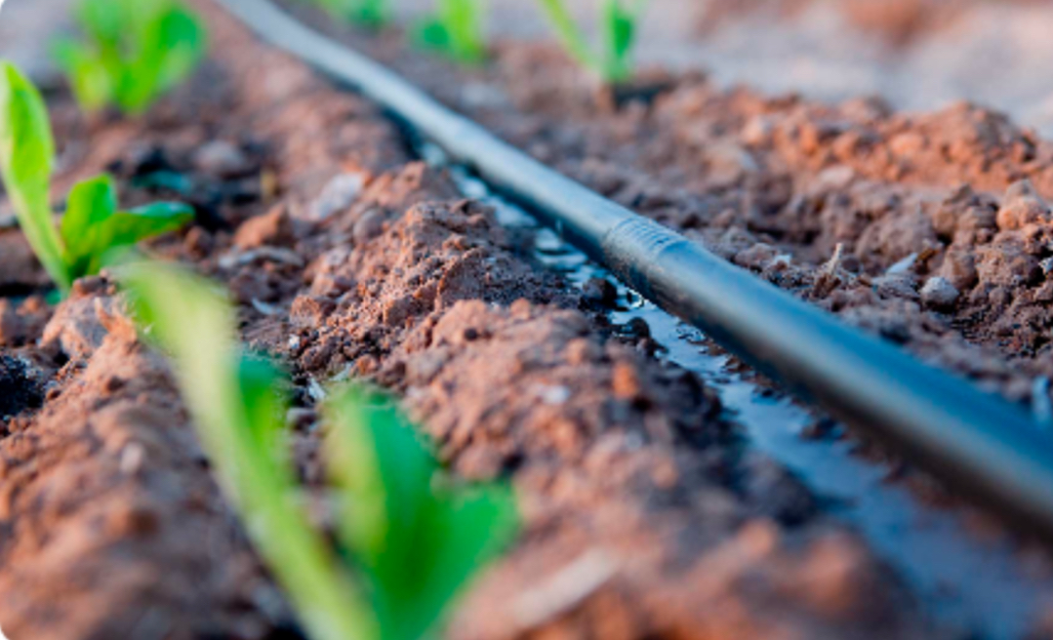
"Water is the driving force behind all nature." - Leonardo da Vinci
These wise words remind us of the invaluable importance of water. As we ponder the impact of water irrigation, it is vital to approach this issue with careful consideration and a proactive mindset to ensure a sustainable future

Slide 2
How to conserve water?
1
2
3
1. Efficient Irrigation Techniques Adopting precision irrigation methods, such as drip or sprinkler systems, can significantly reduce water usage while maintaining agricultural productivity.
2. Crop Selection and Rotation Choosing crops that are better suited to local climatic conditions can optimize water usage. Implementing crop rotation practices can help minimize the negative impact of water irrigation on the soil.
3.Water Management Policies Implementing effective water management regulations and policies can promote responsible water usage and ensure equitable distribution among agricultural, industrial, and residential sectors

Slide 3
Use of Technology in Water Irrigation
Smart Irrigation Systems
Remote Monitoring
Smart irrigation systems use sensors, weather data, and automation to optimize watering schedules. They adjust irrigation based on real-time conditions, reducing water waste and promoting efficient water usage.
Remote monitoring technologies enable farmers and irrigation professionals to monitor water usage, detect leaks, and manage irrigation systems from a distance. This improves water management and reduces maintenance costs.
Data Analysis
Automated Weather Stations
Data analysis tools help analyze water usage patterns, identify inefficiencies, and make data-driven decisions. By identifying areas for improvement, water resources can be conserved and irrigation techniques can be optimized.
Automated weather stations provide accurate and timely weather information. This data helps in determining optimal irrigation timings and adjusting watering schedules based on real-time weather conditions.

Slide 4
Impact of Water Irrigation on Agriculture
Increase in yields | Water irrigation has increased the production of crops significantly, leading to higher yields and greater food security.
Conservation of Resources | Water irrigation systems conserve water resources by reducing wastage and increasing efficiency.
Job Creation | Water irrigation has created new employment opportunities in rural areas, benefitting local economies.

Slide 5
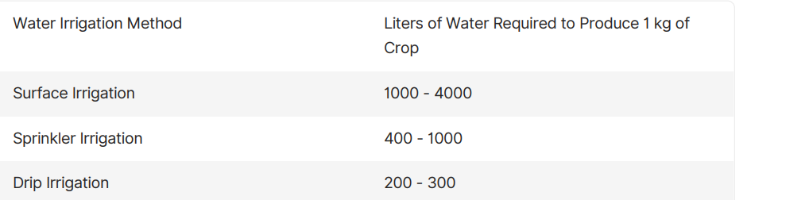
Water Usage Comparisons
The table shows the amount of water required to produce 1 kg of crop using different water irrigation methods. As you can see, drip irrigation uses the least amount of water while surface irrigation uses the most. This highlights the importance of choosing the right irrigation method for a particular crop and soil type to minimize water wastage.

Slide 6
Drip Irrigation
System
Drip irrigation is common in
arid regions and areas where
water conservation is critical.

Slide 7
Water irrigation plays a crucial role in agricultural productivity, but its effects on water resources are a growing concern. In this document, we will explore the impact of water irrigation on water availability, discuss alarming statistics, and propose effective solutions to mitigate its negative consequences. Excessive water irrigation can lead to waterlogging and salinization, causing soil degradation and reduced crop yields. Additionally, it can deplete groundwater reserves and disrupt aquatic ecosystems, impacting biodiversity.
Irrigation has played a crucial role in agriculture for centuries, but it has also posed significant challenges for water resources. In the past, primitive irrigation methods like furrow and flood irrigation were inefficient, leading to excessive water use and wastage. These practices often resulted in soil salinity, waterlogging, and reduced crop yields. In the current scenario, modern irrigation techniques systems have been developed to address these issues. However, challenges still persist. Here are some key problems with irrigation today:

Slide 8
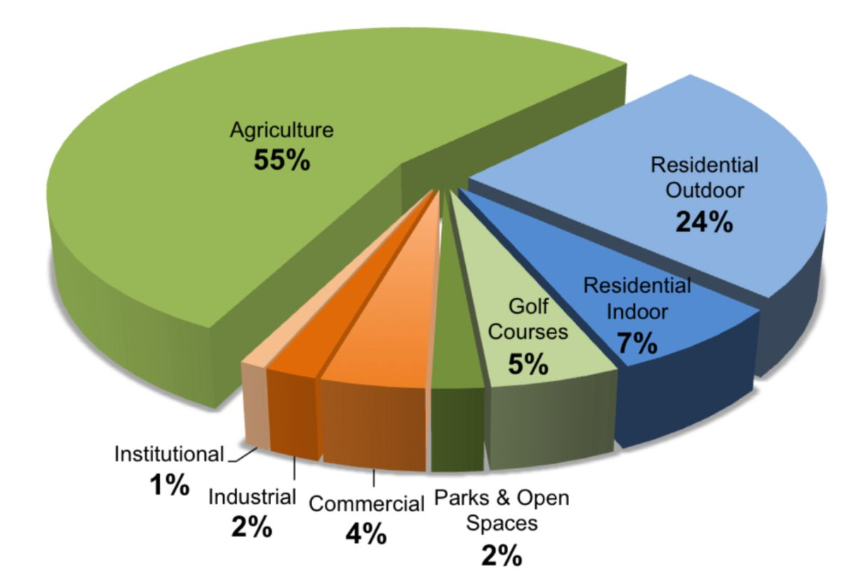
Recent studies reveal alarming data on the effects of water irrigation. For instance, agriculture accounts for approximately 70% of global fresh water usage, with inefficiencies resulting in significant water losses. These patterns exacerbate water scarcity issues worldwide:

Slide 9
1. Water Scarcity
2. Water Pollution
Agricultural irrigation accounts for a significant portion of global water use.
The growing demand for water in agriculture, depletion of freshwater sources,
has intensified competition for this finite resource.
The use of pesticides and fertilizers in irrigated agriculture can lead to the contamination of water sources,
harming aquatic ecosystems and affecting drinking water quality.
3. Inequity
4. Ecosystem Impact
Access to irrigation facilities is often unevenly distributed, with small-scale and marginalized farmers facing limited access to water resources.
Excessive water extraction for irrigation can harm local ecosystems by reducing the flow of rivers and depleting groundwater reserves

Slide 10
How to conserve water?
1
2
3
1. Efficient Irrigation Techniques Adopting precision irrigation methods, such as drip or sprinkler systems, can significantly reduce water usage while maintaining agricultural productivity.
2. Crop Selection and Rotation Choosing crops that are better suited to local climatic conditions can optimize water usage. Implementing crop rotation practices can help minimize the negative impact of water irrigation on the soil.
3.Water Management Policies Implementing effective water management regulations and policies can promote responsible water usage and ensure equitable distribution among agricultural, industrial, and residential sectors

